Slide 1
Chapter 1: Definition and Characteristics of Applied Behavior Analysis

Slide 2
Development of ABA
Skinner did not object to cognitive psychology’s concern with thoughts & feelings
Events taking place “inside the skin”
Referred to these as “private events”
They are behavior to be analyzed with the same conceptual & experimental tools used to analyze publicly observable behavior

Slide 3
Development of ABA
Radical behaviorism
Attempts to explain all behavior, including private behavior (e.g. thinking & feeling)
Methodological behaviorism
Philosophical position that considers behavioral events that cannot be publicly observed to be outside the realm of the science

Slide 4
Development of ABA
Radical behaviorism (Skinner’s behaviorism)
Makes three assumptions about the nature of private events
Private events such as thoughts and feelings are behavior
Behavior that takes place within the skin is distinguished from other (“public”) behavior only by its inaccessibility

Slide 5
Development of ABA
Radical behaviorism (Skinner’s behaviorism)
Private behavior has no special properties & is influenced by (i.e. is a function of) the same kinds of variables as publicly accessible behavior
Includes & seeks to understand all human behavior
Far-reaching & thoroughgoing
Dramatic departure from other conceptual systems

Slide 6
Development of ABA
Methodological behaviorism
Rejects all events that are not operationally defined by objective assessment
Deny existence of “inner variables” or consider them outside the realm of scientific account
Acknowledge the existence of mental events but do not consider them in the analysis of behavior

Slide 7
Development of ABA
Methodological behaviorism
Use scientific manipulations to search for functional relationships between events
Restrictive view since it ignores major areas of importance

Slide 8
Development of ABA
Mentalism
Approach to understanding behavior that assumes that a mental or “inner” dimension exists that differs from a behavioral dimension & that phenomena in this dimension either directly cause or at least mediate some forms of behavior
Relies on hypothetical constructs and explanatory fictions
Dominated Western intellectual thought & most psychological theories (e.g. Descartes, Freud, Piaget)

Slide 9
Development of ABA
Mentalism (continued)
Relies on the premise of explanatory fiction (e.g. knowledge)
A fictitious variable that often is simply another name for the observed behavior that contributes nothing to an understanding for the variables responsible for developing (or maintaining) the behavior
Circular view of the cause & effect

Slide 10
Development of ABA
Structuralism
Rejects all events that are not operationally defined by objective assessment
Restrict activities to descriptions of behavior
Make no scientific manipulations; do not address causal questions

Slide 11
Chapter 2: Basic concepts

Slide 12
Definition of Behavior
Behavior of an organism
Displacements in space through time
Temporal locus
Temporal extent
Repeatability
Results in a measurable change in some aspect of the environment

Slide 13
Behavior vs. Response
Behavior in reference to a larger set or class of responses sharing certain
Physical characteristics
Functions
Response
Specific instance of behavior

Slide 14
Descriptions of behavior: Structural and functional
Response topography
Form
Physical characteristics
Functional
Effects of behavior on environment
Notes:
Example: Fire (seeing sign vs. smelling fire)

Slide 15
Response Class vs. Repertoire
Response class
A group of responses with the same function
Each response in the group produces the same effect on the environment
Repertoire
Set or collection of knowledge and skills a person has learned that are relevant to a particular setting or tasks

Slide 16
Environment
Johnston & Pennypacker (1993a) definition
Complex, dynamic universe of events that differ from instance to instance
Stimulus
“an energy change that affects an organism through its receptor cells”
Michael, 2004, p. 7

Slide 17
Description of Stimulus Events
Formally
Physical features
Temporally
Occur with respect to a behavior of interest
Functionally
Effects on behavior

Slide 18
Stimulus Class
Any group of stimuli sharing a predetermined set of common elements in one of more of these dimensions
Formal dimensions of stimuli
Temporal locus of stimuli
Behavioral functions of stimulus changes

Slide 19
Formal dimensions of stimuli
Descriptions, measurements, manipulations based on
Size, color, intensity, etc.
Stimuli can be
Social
Nonsocial

Slide 20
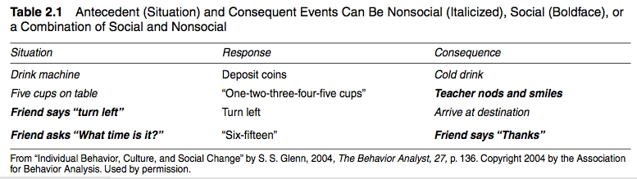
Stimulus Changes: Social & Nonsocial

Slide 21
Temporal locus of stimuli – Big Idea
Consequences combine with the antecedent conditions to determine what is learned
Three-Term Contingency
Antecedent
Behavior
Consequence
Notes:
Behavior is affected by stimulus changes that
Occur prior to (Antecedent)
Immediately after the behavior (Consequence)

Slide 22
Temporal locus of stimuli
Antecedent
Environmental conditions or stimulus changes that exist or occur prior to the behavior
Play a critical part in learning and motivation
Learners do not need to be aware of antecedents for antecedents to effect behavior

Slide 23
Temporal locus of stimuli
Consequence
Stimulus change that follows a behavior of interest
Especially those that are immediate
Relevant to current motivational states
Influence on future behavior
Other consequences have little effect

Slide 24
Behavioral functions of stimulus changes
An immediate but temporary effect of increasing or decreasing the current frequency of the behavior
A delayed but relatively permanent effect in terms of the frequency of that type of behavior in the future
Best understood through a functional analysis of their effects on behavior
Immediate control
Delayed, or no apparent effect
Notes:
USED

Slide 25
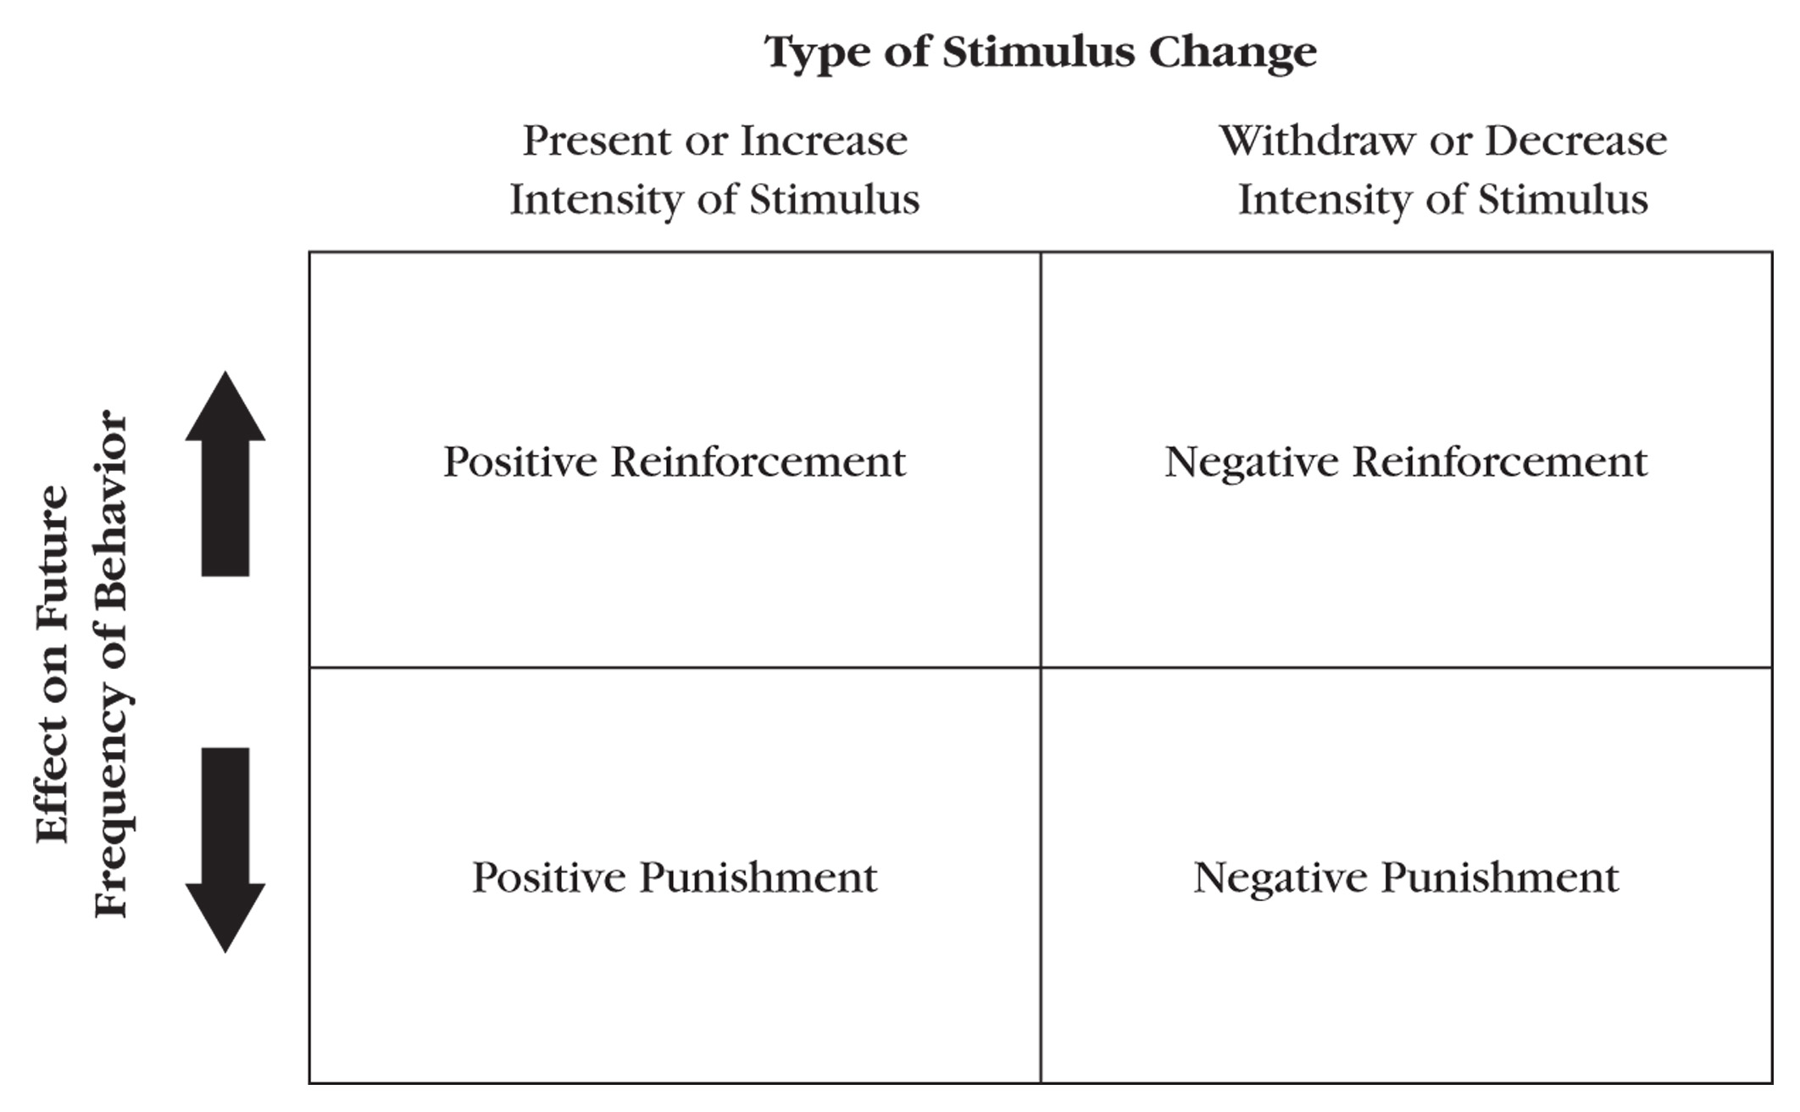
Type of Stimulus Change

Slide 26

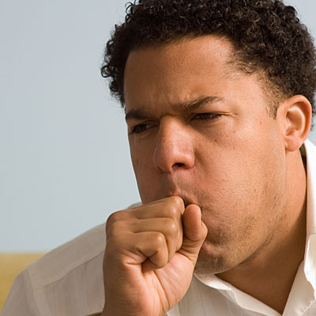
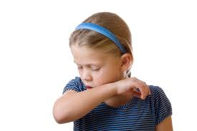
Respondent Conditioning

Slide 27
Don’t Forget Operant Conditioning First
Operant behaviors are controlled by their consequences:
Positive and Negative Reinforcement or Punishment
Learned behaviors because of the consequences that follow them

Slide 28
Operant Behavior
Any behavior whose future frequency is determined primarily by its history of consequences
Selected
Shaped
Maintained by consequences
Defined functionally, by their effects
Notes:
History and verbal community.
Parents, teachers reinforced you when need.
Functional relation, not correlation
Cry evoke the xx get the bottle
Not just once, many times

Slide 29
Selection by Consequences
All forms of life, from single cells to complex cultures, evolve as a result of selection with respect to function
Pennypacker, 1994, pp. 12 -13
Ontogeny
Operates during the lifetime of the individual
Phylogeny (evolution)
Natural selection in the evolution of a species
Notes:
Ontogeny -- one person history
Phylogeny –
Eating cricket someone know how to deal with it
Other people easy get sick
Ontogeny based on consequence

Slide 30
Operant Conditioning
Process and selective effects of consequences on behavior
“Functional consequence”
Stimulus change that follows a given behavior in a relatively immediate temporal sequence and alters the frequency of the type of behavior in the future
Notes:
Antecedent and consequence a study

Slide 31
Discriminated Operant
Occurs more frequently under some antecedent conditions than it does under others
Stimulus Control
Differential rates of operant responding observed in the presence or absence of antecedent stimuli
Due to pairings (antecedent/consequence) in the past, antecedents acquire the ability to control operant behavior
Notes:
Across all different stimuli

Slide 32
Motivating Operations
Alters the current value of stimulus changes as reinforcement or punishment
Satiation (full)
Deprivation (lost)

Slide 33
Respondent Behaviors
Respondent behaviors are “elicited” by antecedent stimuli.
Reflexes (unlearned)
Examples:
Your response to allergens → sneeze
Your response to bright light →pupils contract
Your response to a tingle in your throat → cough

Slide 34
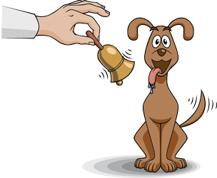
So What is Respondent Conditioning?
Learning occurs due to stimulus-stimulus pairings
New or neutral stimuli (NS) can acquire the ability to ELICIT respondents (Cooper et. al., 2020)
Classical conditioning is the first prime example: PAVLOV

Slide 35
Classical Conditioning
Food in mouth (Unconditioned Stimulus US)= Salivation in mouth when given food (Unconditioned Response UR)
Neutral stimulus (NS)= Metronome played right before food was given to dog

Slide 36
Classical Conditioning
Food was immediately followed by the sound of the metronome for a few trials. This resulted in:
Dogs salivating every time the metronome was played
Metronome= conditioned stimulus (CS)
Salivating in the presence of the metronome= CR (conditioned response)

Slide 37
Some Important Terms
Unconditioned stimulus (US)
Unconditioned response (UR)
Conditioned stimulus (CS)
Conditioned response (CR)
Neutral Stimulus (NS)

Slide 38
Unconditioned Stimulus
US
(food pellet)
An US elicits behavior without any learning history with regard to that stimulus.

Slide 39
Unconditioned Response
US
(food pellet)
UR
(salivation)
An UR is a reflex response elicited by an US. The food pellet elicits salivation.

Slide 40
Respondent Conditioning
US
(food pellet)
UR
(salivation)
pairing
NS
(click of pellet dispenser)
Following repeated pairings of the US and a neutral stimulus...

Slide 41
Respondent Conditioning
CS
(click of pellet dispenser)
CR
(salivation)
…the neutral stimulus, when presented alone, elicits the CR. The neutral stimulus is now a CS (no longer neutral) because of the conditioning history.

Slide 42
In respondent conditioning, the conditioned and unconditioned stimuli are presented without regard to the organism’s behavior. (no contingency)
Notes:
Rat did not have to do anything in previous example

Slide 43
Respondent vs. Operant
Respondent conditioning
Stimuli precede response
No response required
Involuntary
Operant conditioning
Consequences follow responses
Response required
Voluntary

Slide 44

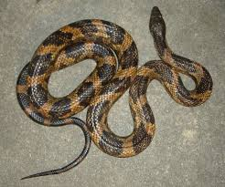
Phobias and Fears
Responses that can become CR in presence of neutral stimuli (i.e., spiders, frogs, heights, etc.) after multiple stimulus-stimulus pairings
Auditory
Visual
Tactile
Gustatory
Vestibular
Social
Thermal
Olfactory
Notes:
https://www.youtube.com/watch?v=Bnos94Rtujw

